Slide 1









Whiteboardmaths.com
7
2
1
5
© 2004 All rights reserved

Slide 2

Intro
Graphs of Real-Life Situations (1)
Discuss what happens to d as t increases in each of the graphs below, then match each graph to a statement on the right.
d
d
d
2
d increases steadily
1
d remains constant
5
d decreases rapidly
1
t
2
t
3
t
4
d increases rapidly
6
d increases steadily, then decreases rapidly
d
d
d
3
d decreases steadily
4
t
5
t
t
6
Remember: The steeper the line, the faster the rate of increase/decrease.

Slide 3
Graphs of Real-Life Situations (2)
Discuss what happens to p as q increases in each of the graphs below, then match each graph to a statement on the right.
p increases quickly at first, then more slowly
p
p
2
p increases slowly at first, then more quickly
1
q
2
q
1
p increases slowly at first, then more quickly then slowly again
p
4
p
p increases quickly at first, then more slowly, then quickly again
3
q
4
q
3

Slide 4

Experiment
Graphs of Real-Life Situations (3)
A test tube containing a chemical liquid is used in an experiment. During the experiment the depth d of the liquid changes with time t. Match the different parts of the graph to the statements below.
d
2
1
5
4
3
3
Some liquid is poured out quickly.
t
1
Liquid is added slowly to the test tube.
4
Some liquid is poured in quite quickly.
2
The level of the liquid remains constant.
5
The test tube is emptied.

Slide 5
Population
Graphs of Real-Life Situations (4)
The graphs below show how the population of four small African countries changed over a 50 year period. Match each graph to a statement.
The population increased steadily over the period.
1
2
Population
Population
The population increased slowly at first, but then increased more quickly.
1955
2005
1955
2005
The population declined steadily over the period.
3
4
Population
Population
The population increased quickly at first, but then increased more slowly.
1955
2005
1955
2005

Slide 6

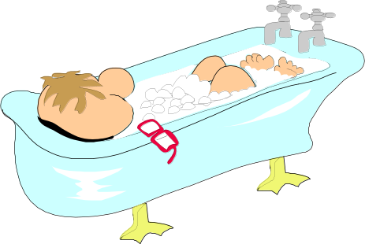

Archimedes
Graphs of Real-Life Situations (5)
The graph below shows the variation in the depth of water as Archie takes his early morning bath. Match the different parts of the graph to the statements shown.
5
Relaxes in bath.
Pulls the plug.
4
6
2
3
Depth of
Water
7
1
Cold tap turned off, gets undressed.
Gets into bath.
Time
Gets out of bath.
Turns off hot tap.
Hot and cold taps turned on.

Slide 7

Water 1
Water is poured into each of the containers below at a constant rate of 250 ml per second. The graphs show how the depth d of the water varies with time t. Match the container to its corresponding graph.
A
B
C
D
d
d
d
d
1
t
2
t
3
t
4
t

Slide 8
Water is poured into each of the containers below at a constant rate of 250 ml per second. The graphs show how the depth d of the water varies with time t. Match the container to its corresponding graph.
A
B
C
D
d
d
d
d
1
t
2
t
3
t
4
t

Slide 9
Water is poured into each of the containers below at a constant rate of 250 ml per second. The graphs show how the depth d of the water varies with time t. Match the container to its corresponding graph.
A
B
C
D
d
d
d
d
1
t
2
t
3
t
4
t

Slide 10
Water is poured into each of the containers below at a constant rate of 250 ml per second. The graphs show how the depth d of the water varies with time t. Match the container to its corresponding graph.
A
B
C
D
d
d
d
d
1
t
2
t
3
t
4
t

Slide 11
Water is poured into each of the containers below at a constant rate of 250 ml per second. The graphs show how the depth d of the water varies with time t. Match the container to its corresponding graph.
A
B
C
D
d
d
d
d
1
t
2
t
3
t
4
t

Slide 12
Chemical 1
A liquid is poured into each of the containers below. The graphs show how the surface diameter d varies as the height of the liquid h increases. Match each container with its corresponding graph.
d
d
d
d
A
B
C
D
d
d
d
d
h
1
h
2
3
h
4
h

Slide 13
A liquid is poured into each of the containers below. The graphs show how the surface diameter d varies as the height of the liquid h increases. Match each container with its corresponding graph.
d
d
d
d
A
B
C
D
d
d
d
d
1
h
2
h
3
h
4
h

